Slide 1
Mahsa Derakhshani mahsa.derakhshani@mail.mcgill.ca
Lectures 22-23
Overview of Ad Hoc Networks and Wi-Fi

Slide 2
Lectures 22-23 - Outline
Introduction of Ad Hoc Networks
Applications of Ad Hoc Networks
Technical Challenges
Design Principles
MAC Protocols
Routing Protocols
Overview of 802.11 Standards
PHY Evolution
MAC Evolution
State of the Art: 802.11ac and 802.11ad

Slide 3
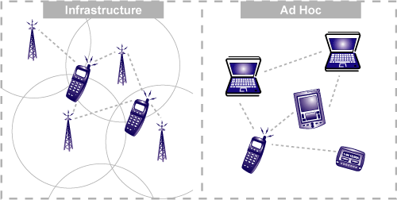
Introduction on Ad Hoc Wireless Networks
Peer-to-peer communications: No backbone infrastructure
Self-organizing network
Multi-hop routing: Each station plays the role of router
Dynamic topology

Slide 4
Ad Hoc vs. Cellular Wireless Networks
Cellular Networks | Ad-hoc Networks
Fixed, pre-located cell sites and base stations | No fixed base stations, very rapid deployment
Static backbone network topology | Highly dynamic network topologies
Relatively favorable environment and stable connectivity | Hostile environment (losses, noise) and irregular connectivity
Detailed planning before base stations can be installed | Ad hoc network automatically forms and conforms to change
High setup costs and large setup time | Cost-effective and less setup time

Slide 5
Applications for Ad Hoc Networks
Applications | Descriptions/Services
Data Networks | Support direct data exchange between personal digital assistants (PDAs) without having an access point
Sensor Networks | Collection of a large number of small nodes with sensing, computation, and wireless networking capabilities, used to collect real time data to automate everyday functions. There is a wide range of applications for sensor networks, e.g., healthcare monitoring, industrial monitoring, smart grid and etc.
Tactical Networks | Military communications at battlefield where there is no network infrastructure

Slide 6
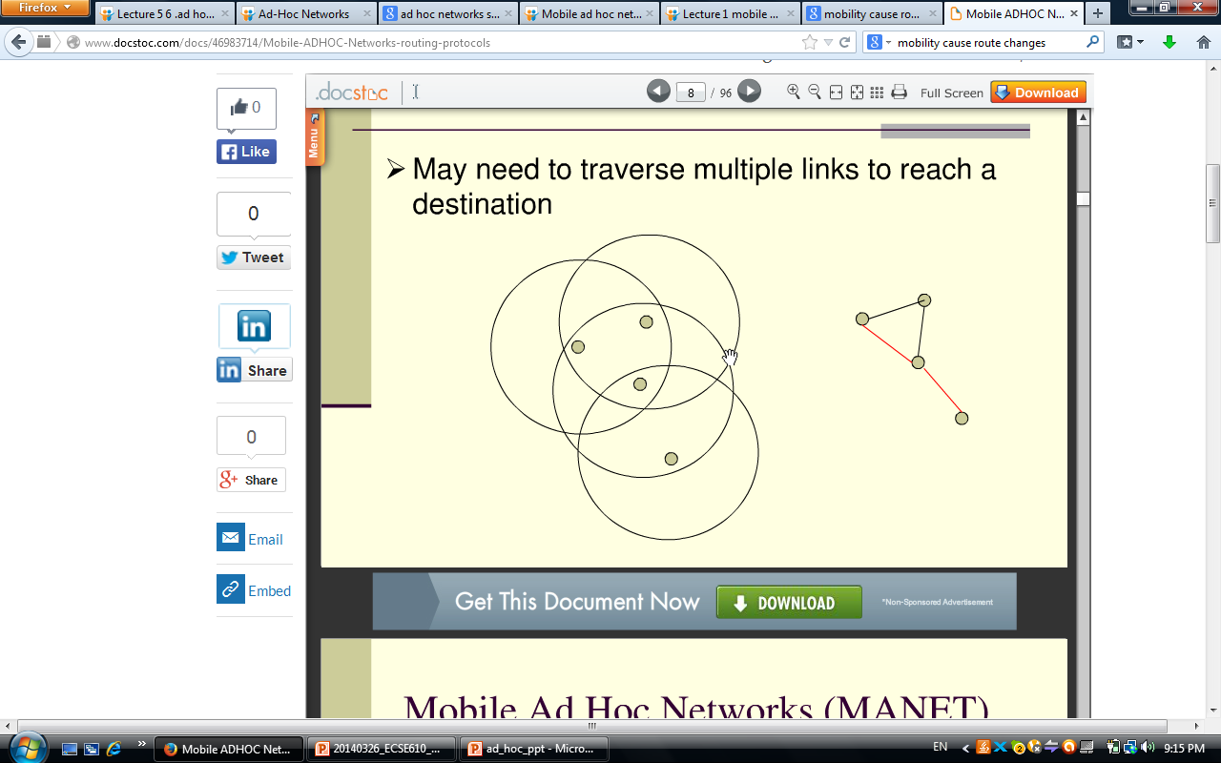
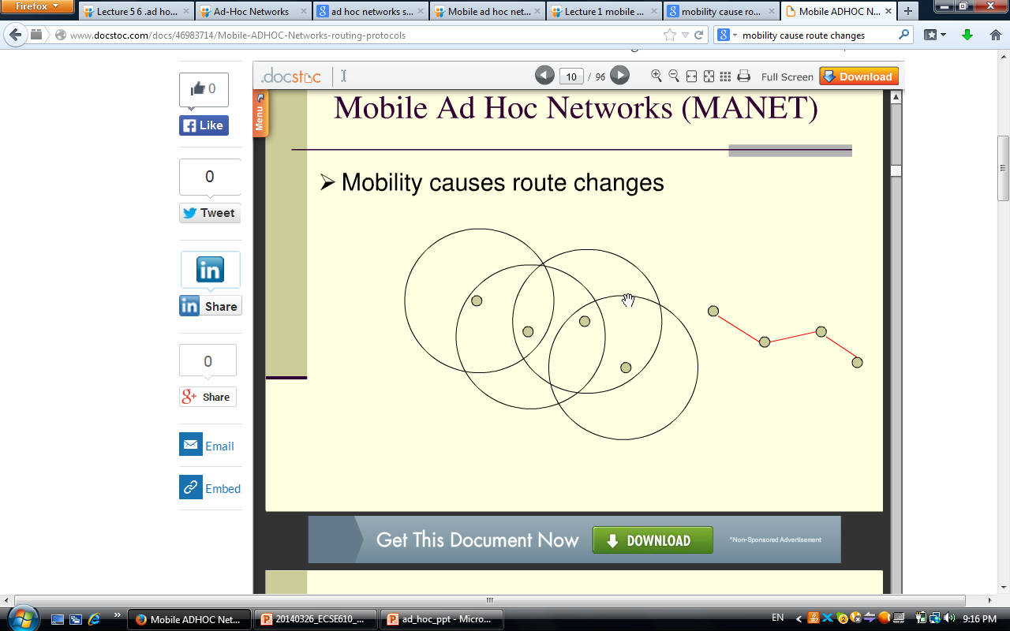
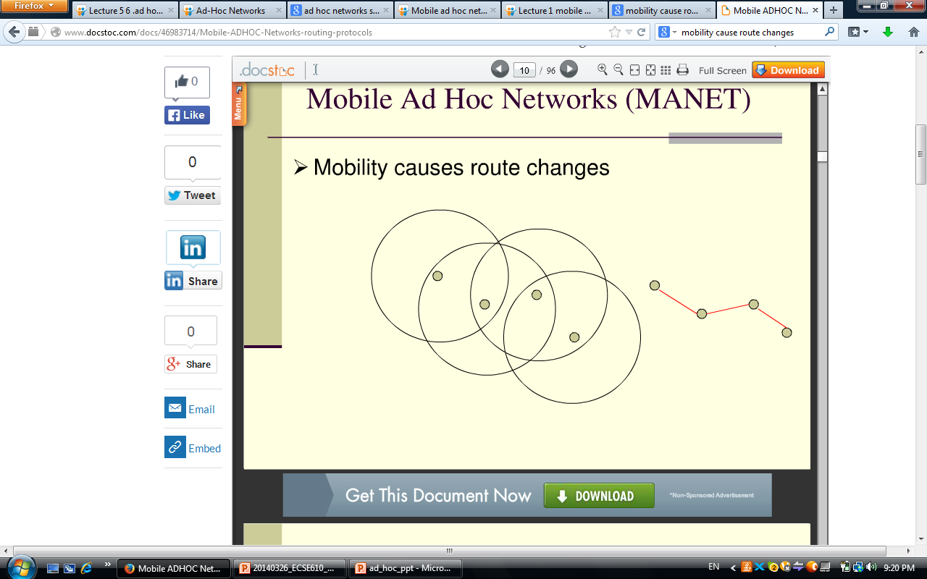
Technical Challenges of Ad Hoc Networks
Limited transmission range
Scalability
Energy constraints
Routes changes
Packet losses
Device heterogeneity

Slide 7
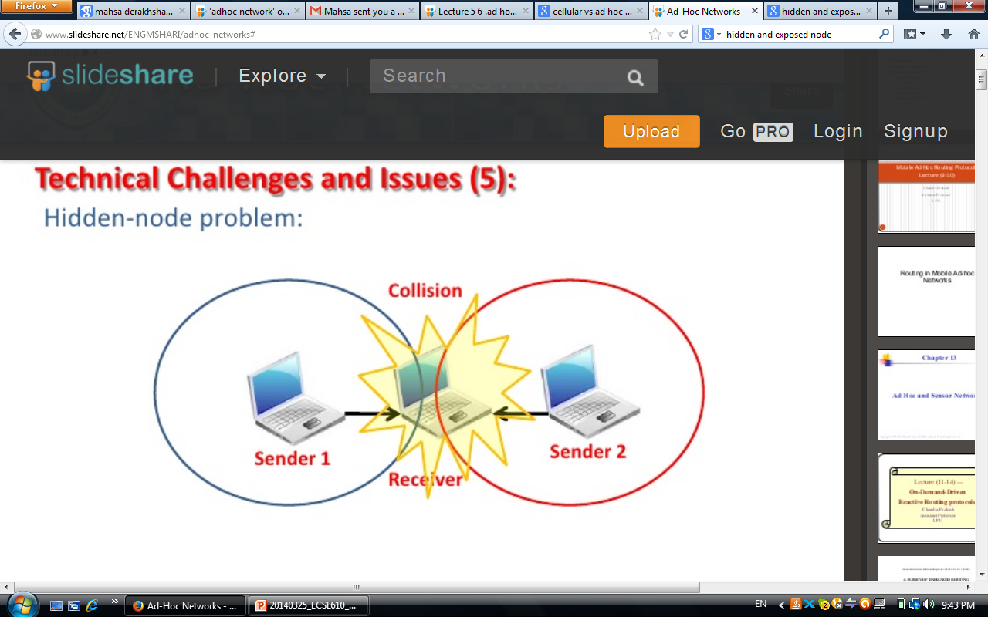
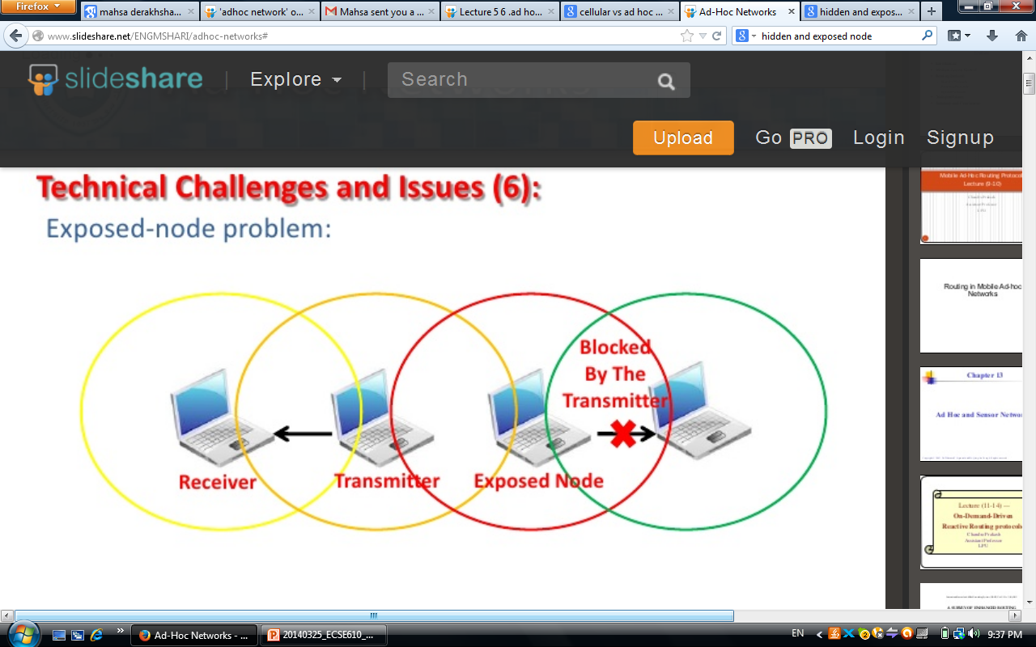
Technical Challenges of Ad Hoc Networks
Hidden terminals
Exposed terminals

Slide 8
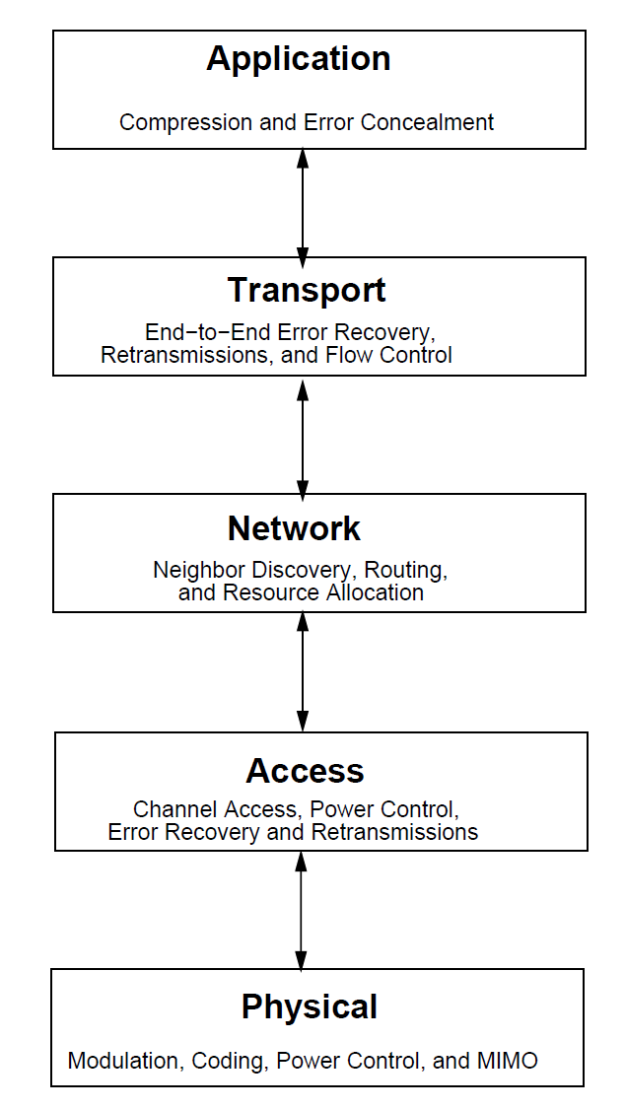
Designs Principles of Ad Hoc Networks
Physical layer design
Data Link layer (MAC) design
Network layer design
Neighbor discovery and topology control
Routing
Resource allocation and flow control
Transport layer design
Application layer design
Cross layer design

Slide 9
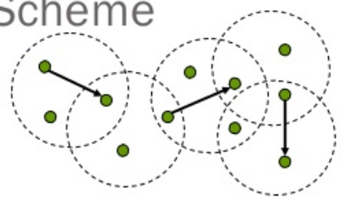
Medium Access Control Protocols
Medium Access Control (MAC) protocol
How users share spectrum and ensure successful packet transmission
Required features and challenges
Distributed operation
Capability of power control
Responsible for retransmissions
Fairness: especially for relaying nodes
Real-time traffic support
Access delay

Slide 10
Medium Access Control Protocols
MAC Protocols for Ad Hoc
Wireless Networks
Contention-based Protocols
with Reservation Mechanisms
Contention-based Protocols
Contention-based Protocols
with Scheduling Mechanisms
Synchronous
Protocols
Asynchronous
Protocols
Sender-initiated
Protocols
Receiver-initiated
Protocols
Single-channel
Protocols
Multi-channel
Protocols

Slide 11
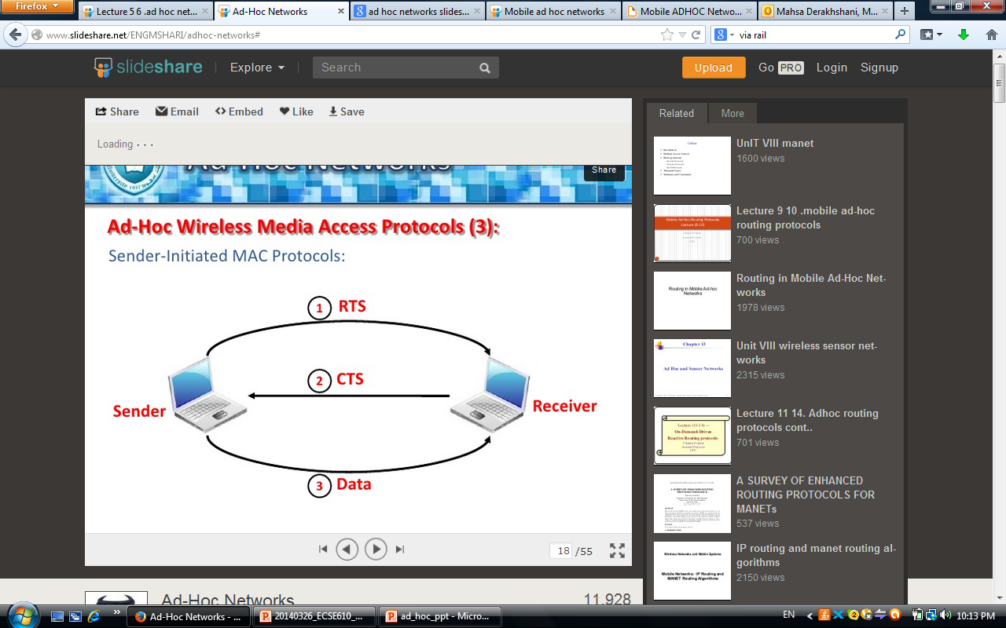
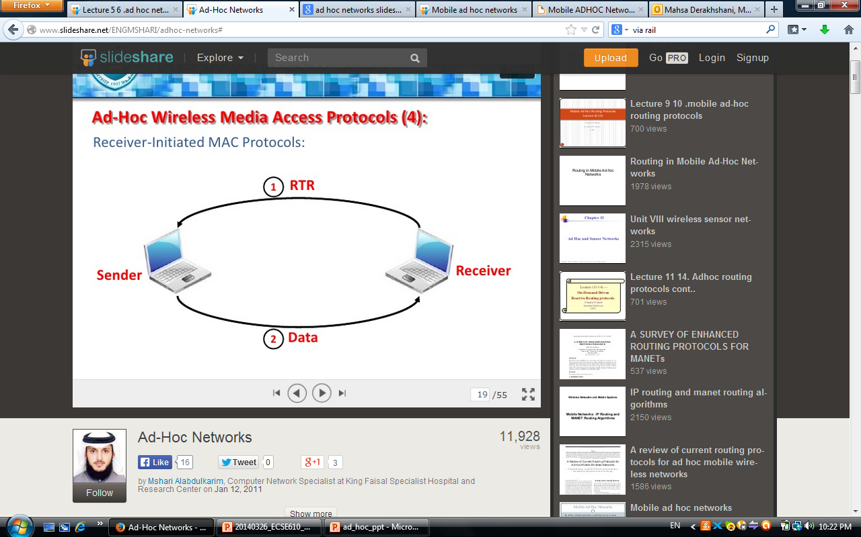
Medium Access Control Protocols
Sender-initiated MAC protocol
Receiver-initiated MAC protocol

Slide 12
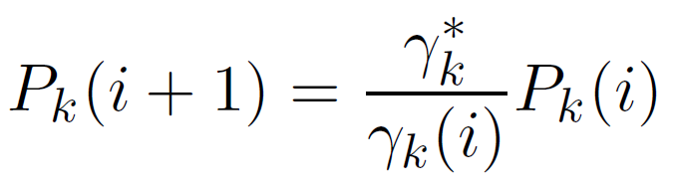
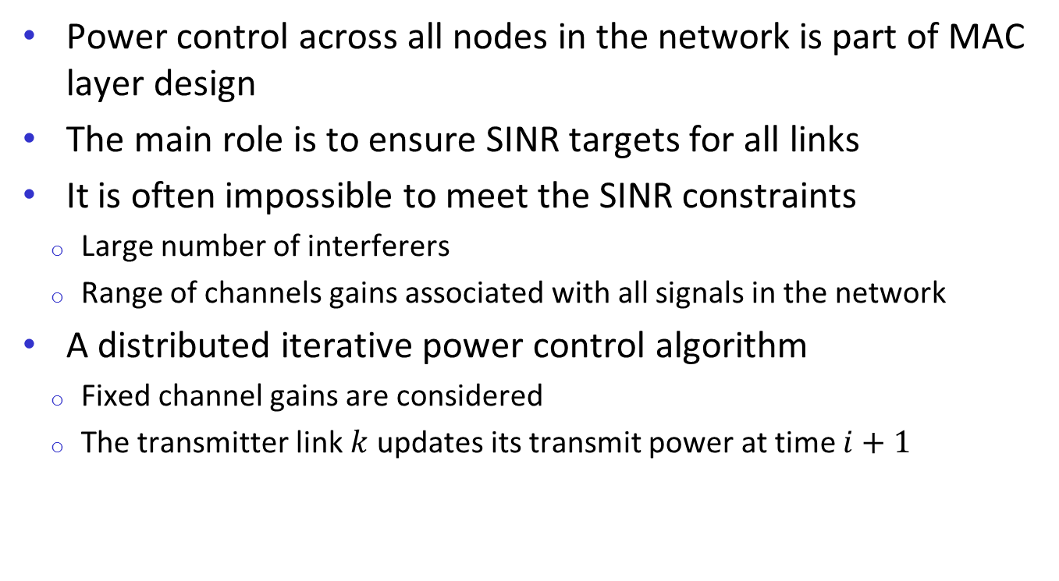
Power Control
Power control across all nodes in the network is part of MAC layer design
The main role is to ensure SINR targets for all links
It is often impossible to meet the SINR constraints
Large number of interferers
Range of channels gains associated with all signals in the network
A distributed iterative power control algorithm
Fixed channel gains are considered
The transmitter link $k$ updates its transmit power at time $i+1$

Slide 13
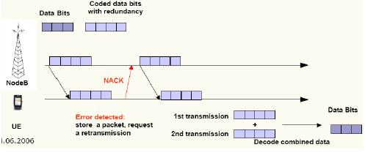
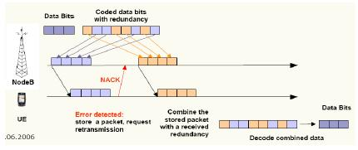
Automatic Repeat Request (ARQ)
Access layer is responsible for retransmission of packets received in errors.
Receiver informs the transmitter about corrupted packet (NACK).
Standard ARQ: retransmitting the original packet
ARQ with incremental redundancy: transmitting some additional coded bits to provide a stronger error correction capability

Slide 14
Routing Protocols
The routing protocol in an ad hoc wireless network is a significant design challenge
No distinction between routers and nodes
No external network setup: “Self-configuring”
Node mobility
Routing Protocols for Ad Hoc
Wireless Networks
Flooding
Proactive / Table-driven
Reactive / On-demand
Centralized
Source-driven
Distributed

Slide 15

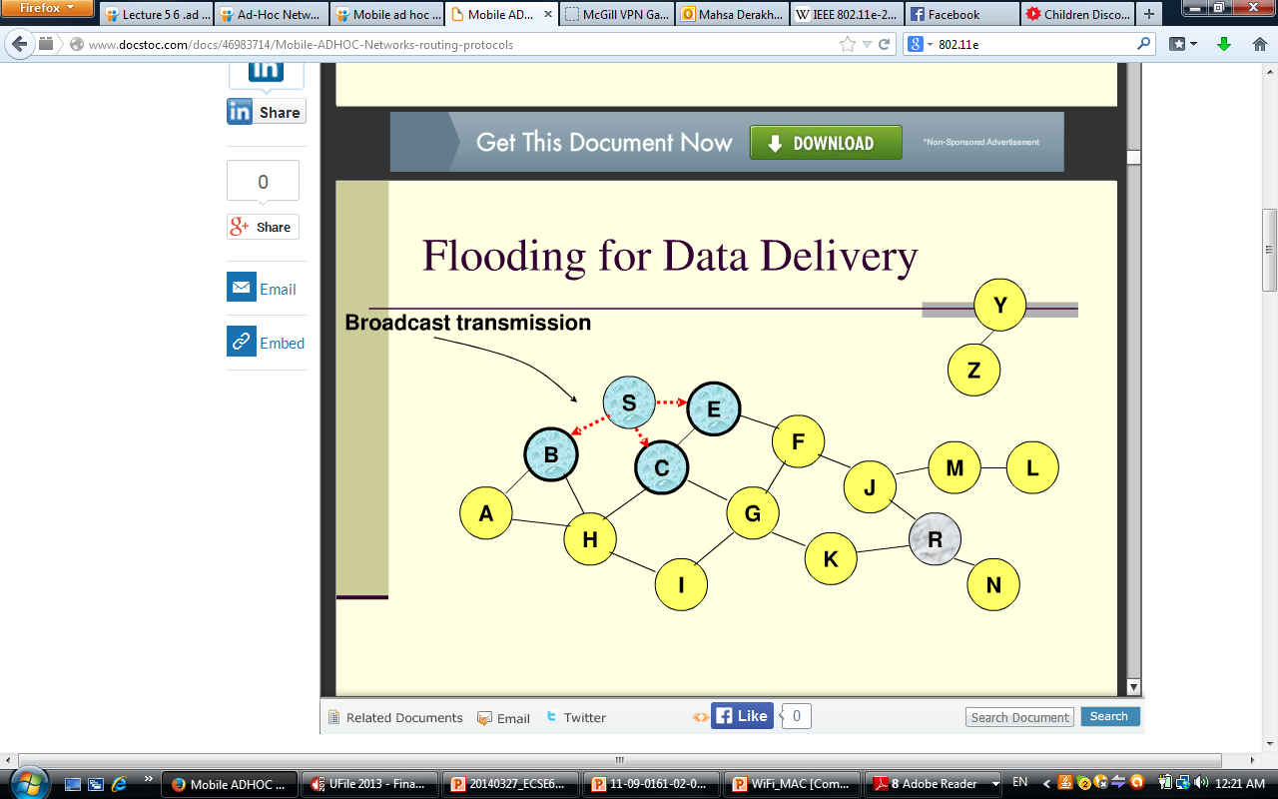
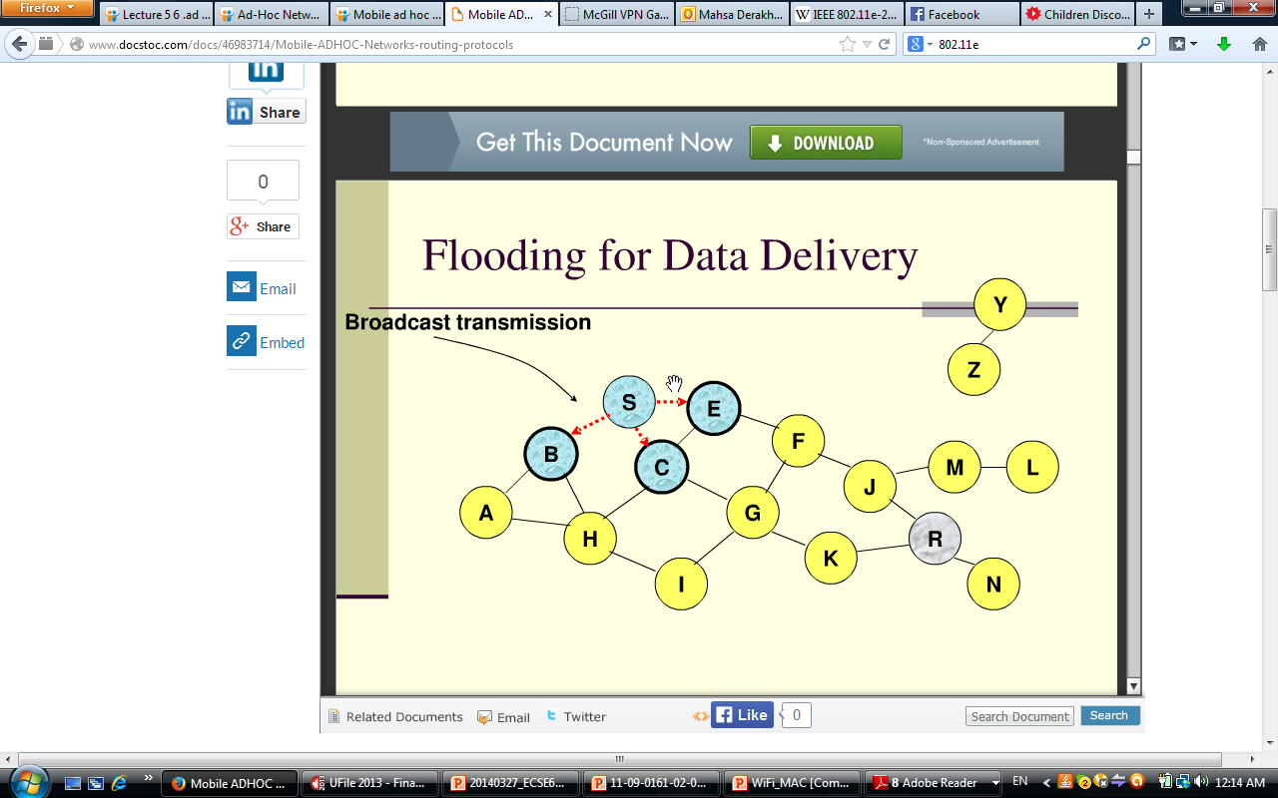
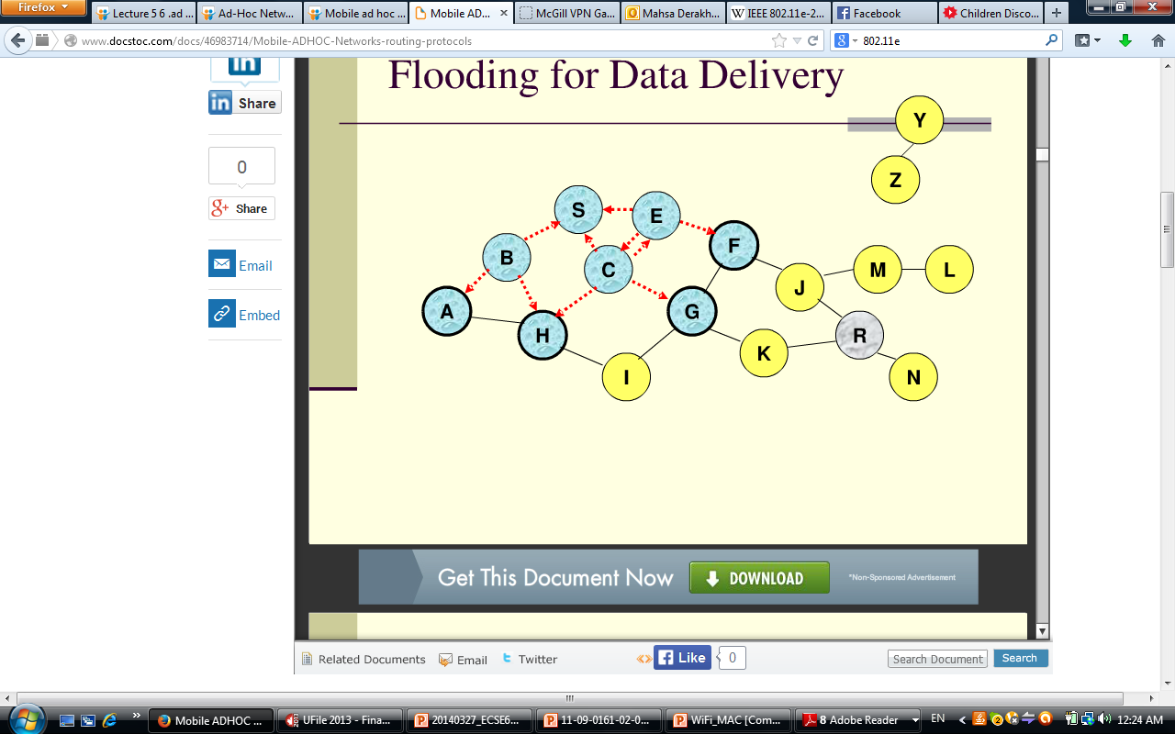
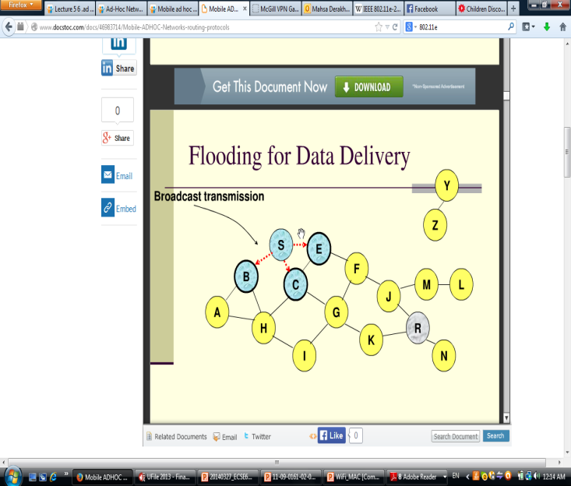
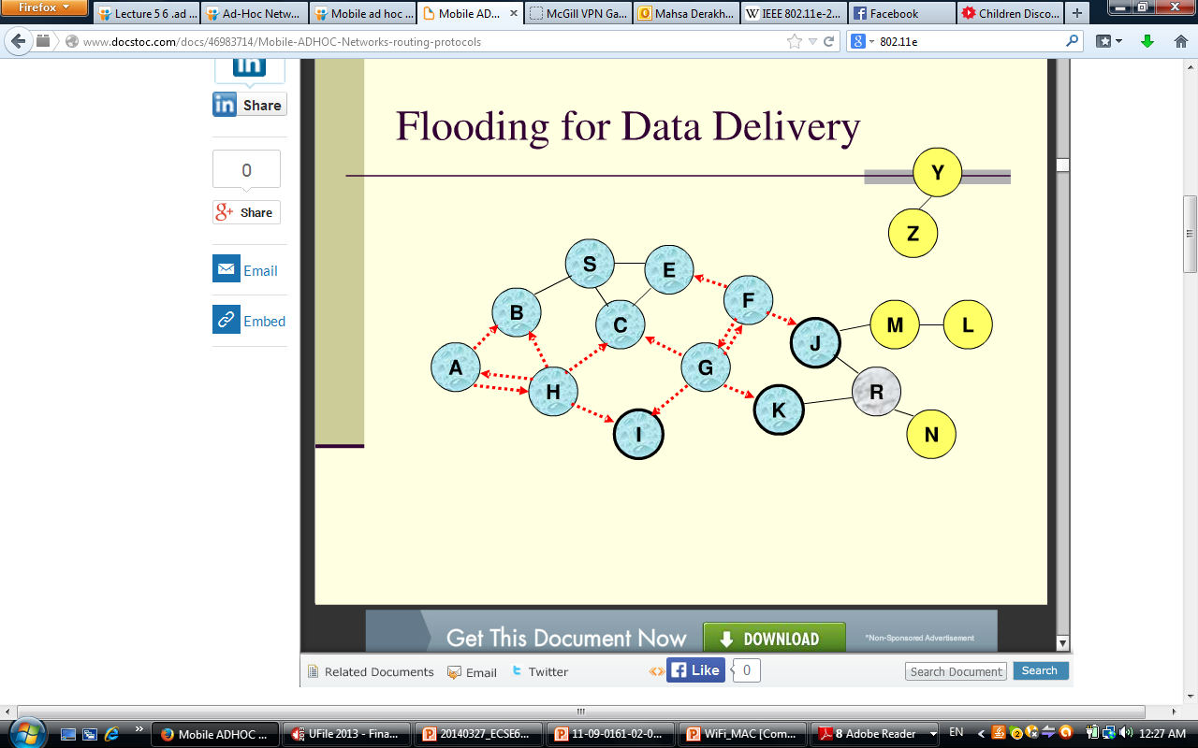
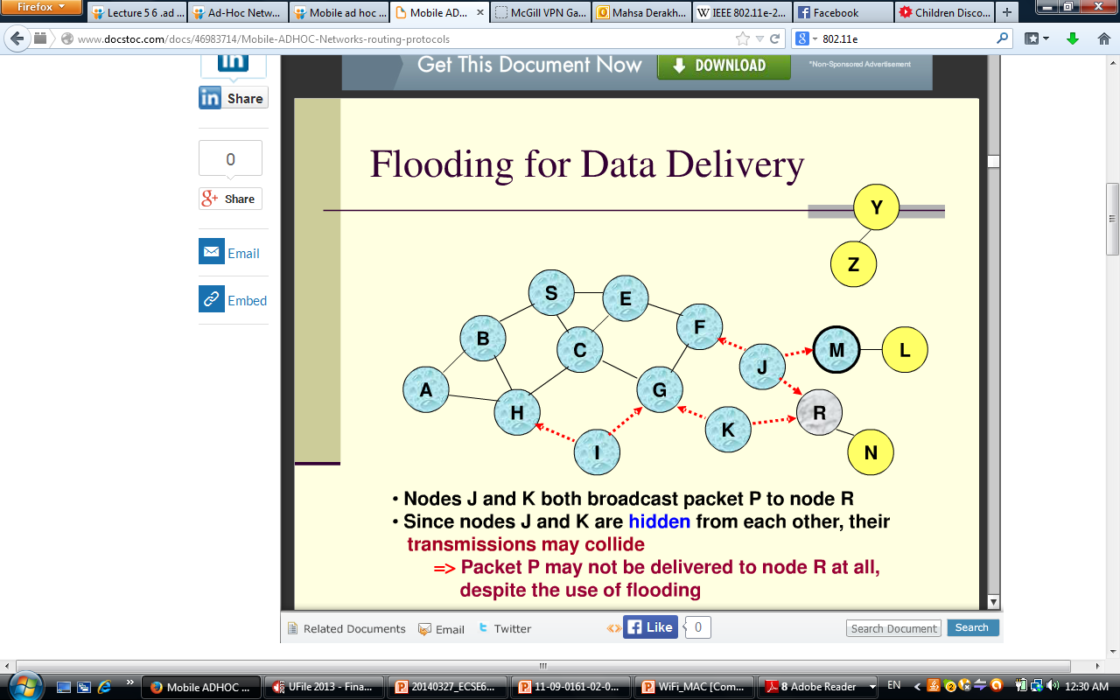
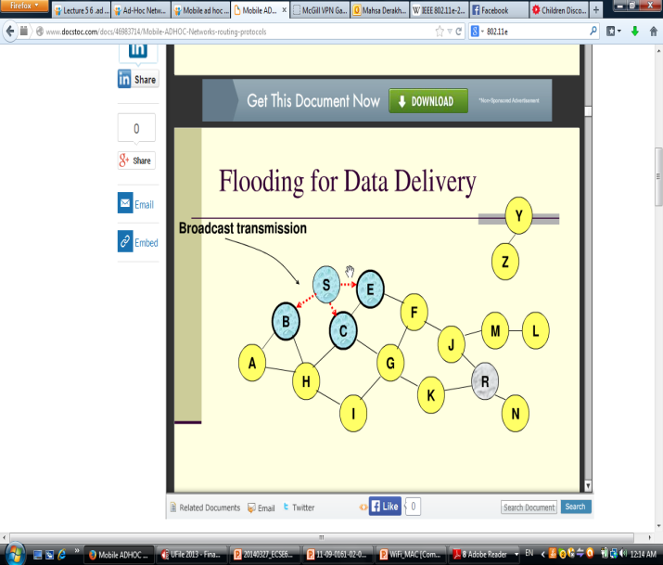

Routing Protocols-Flooding

Slide 16
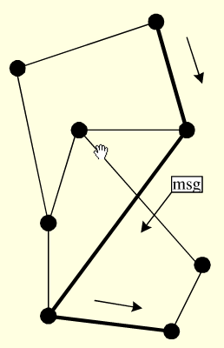
Routing – Flooding Protocol
Advantages
Simplicity
Robust to changing network topology
Requires little routing overhead
Disadvantages
Multiple copies of the same packet traverse through the network
Wasting bandwidth
Wasting battery power

Slide 17
Routing – Proactive Protocols
Proactive protocols
Determine routes independent of traffic pattern
Collect information about channel conditions and network topology
Compute routing tables for all the nodes in the network
Update routing tables at regular intervals because of network dynamics
Route optimization criteria
Distance vector routing minimize hop counts
Link state routing minimize a cost function associated with each link such as delay

Slide 18
Routing – Reactive Protocols
Reactive protocols
Discover routes and maintain them only at the initiation of a source node that has traffic to send to a given destination
Eliminate the overhead of maintaining routing tables for routes not currently in use (advantage)
Entail significant initial delay because route discovery process is just initiated when there is data to send (disadvantage)
Hybrid protocols
Reactive and proactive routing are combined
Reduce the delay associated with reactive routing
Reduce the overhead associated with proactive routing

Slide 19
Routing – Hybrid Protocols
Zone routing protocol
If a packet's destination is in the same zone as the sender, the proactive protocol using an already stored routing table is used to deliver the packet immediately.
If the route extends outside the packet's originating zone, a reactive protocol takes over to check each successive zone in the route to see whether the destination is inside that zone.

Slide 20
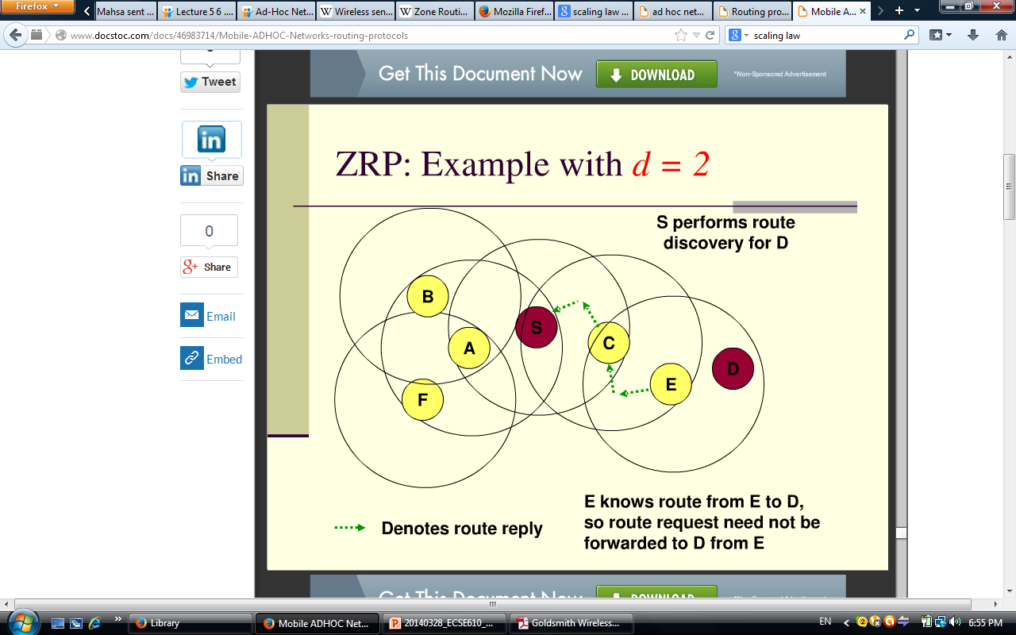
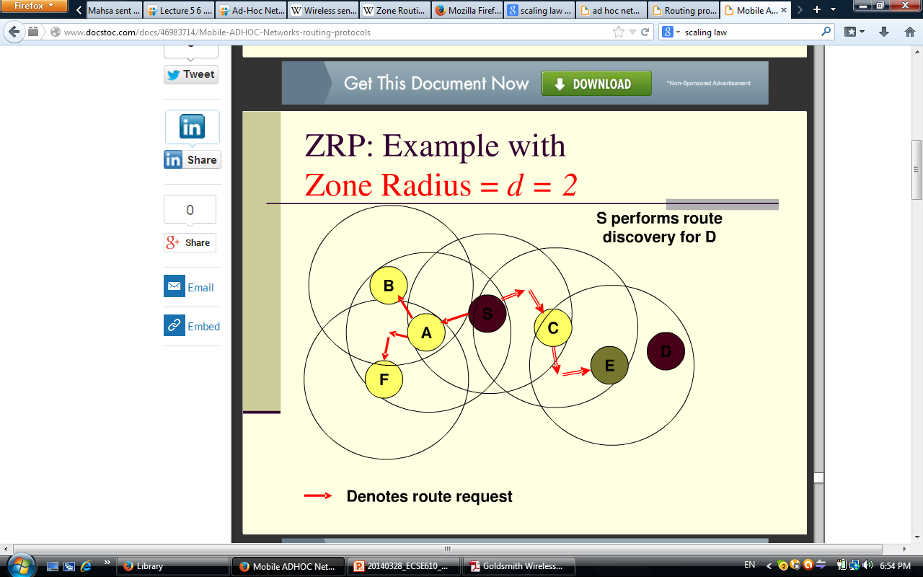
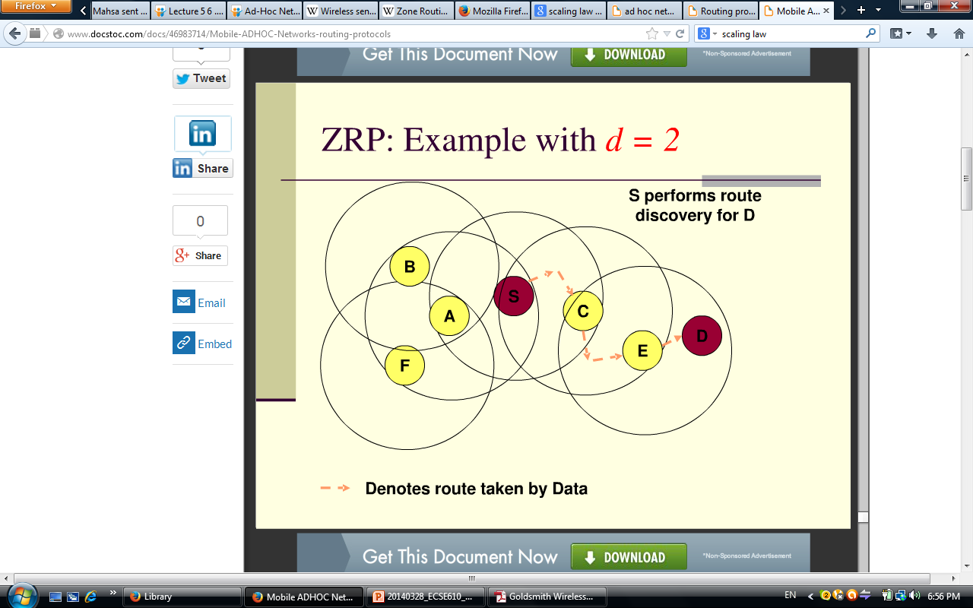
Routing – Hybrid Protocols
Zone routing protocol

Slide 21
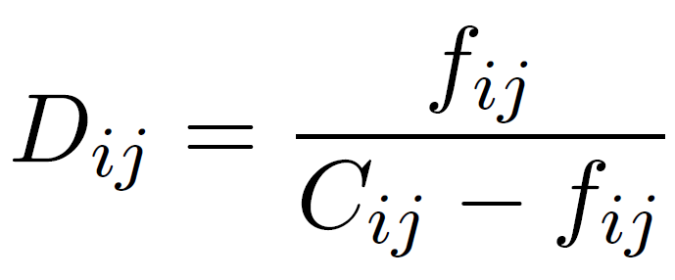
Flow Control
A routing protocol dictates the route a packet follow from a source node to its destination.
If routing sends two much data over a given link congestion
Routing protocol flow control
The delay associated with a given link
Routing, resource allocation and flow control are all interdependent.

Slide 22
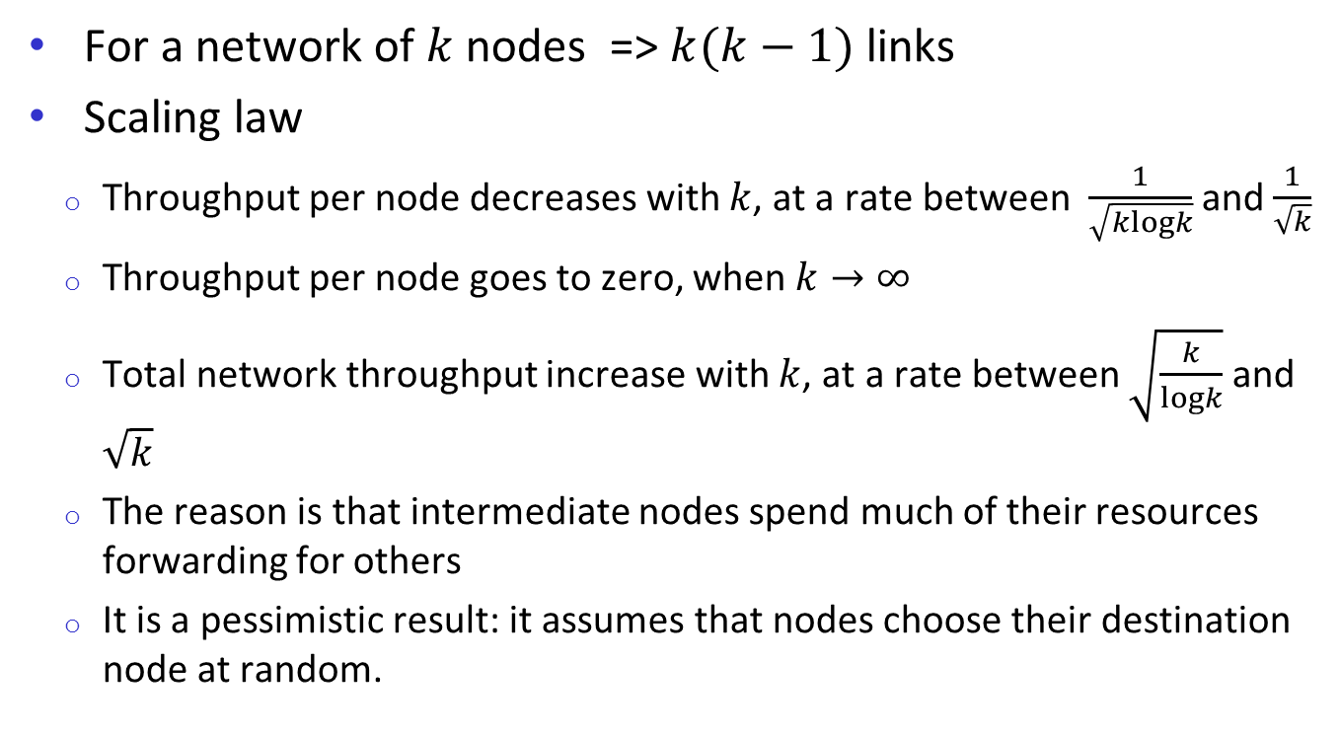
Network Capacity Limits
For a network of $k$ nodes => $k(k−1)$ links
Scaling law
Throughput per node decreases with $k$, at a rate between $\frac{1}{\sqrt{klogk}}$ and $\frac{1}{\sqrt{k}}$
Throughput per node goes to zero, when $k→∞$
Total network throughput increase with $k$, at a rate between $\sqrt{\frac{k}{logk}}$ and $\sqrt{k}$
The reason is that intermediate nodes spend much of their resources forwarding for others
It is a pessimistic result: it assumes that nodes choose their destination node at random.

Slide 23
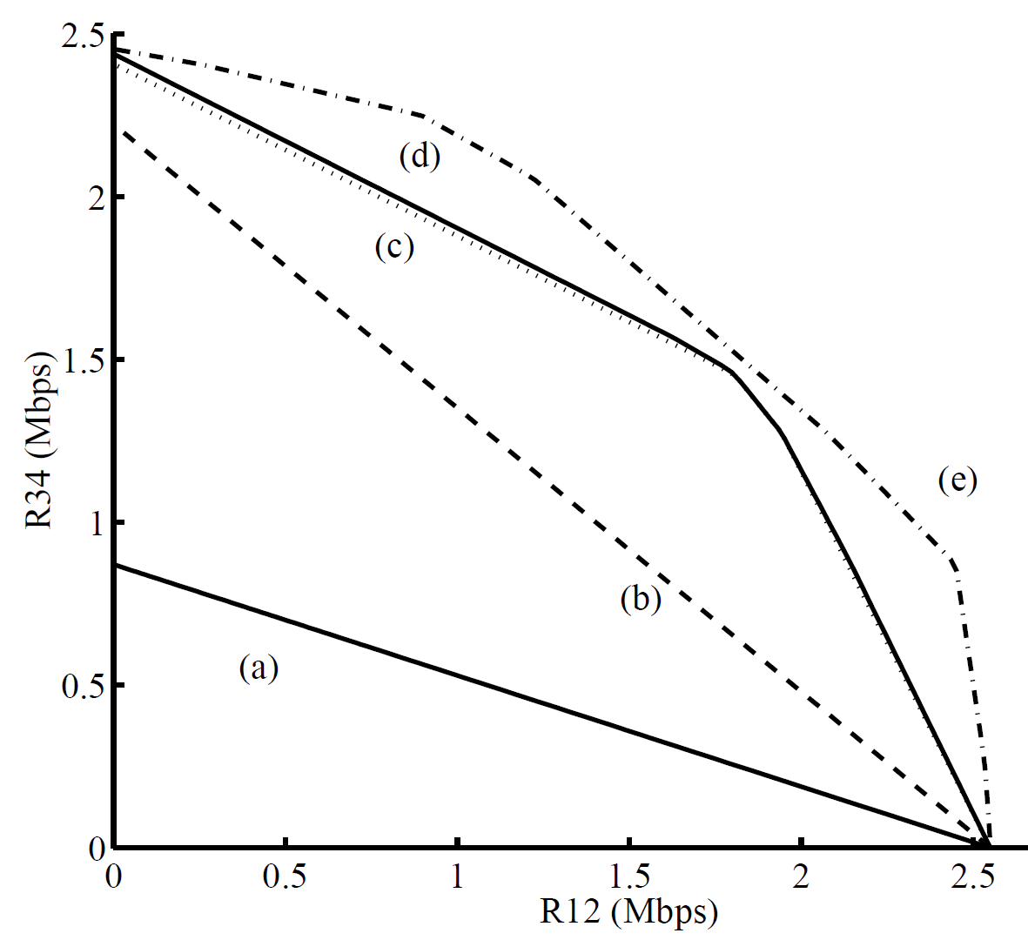
Network Capacity Limits
Capacity region slice of a five-node network
Nodes are randomly located in a square area
Channel model: Path-loss
R12: Achievable rate from node 1to 2
R34: Achievable rate from node 3 to 4
Other nodes just relaying
Variable rate transmission
(a) single-hop, (b) multihop, (c) multihop with spatial reuse, (d) power control and (e) successive interference cancellation.

Slide 24
Wireless Sensor Networks
Nodes powered by non-rechargeable batteries
Data flows to centralized location
Low per-node rates but up to 100,000 nodes.
Data highly correlated in time and space.
Nodes can cooperate in transmission, reception, compression, and signal processing.

Slide 25
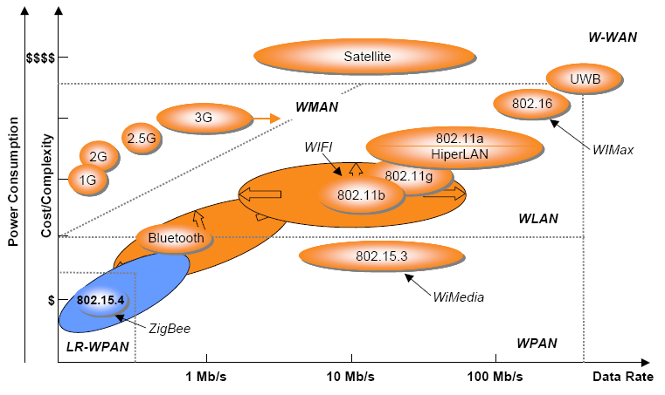
Wireless Protocols Comparison

Slide 26
IEEE 802.15.4 / ZigBee Radios
IEEE 802.15.4 is a set of MAC and PHY specifications for implementing low-rate wireless personal area network (LR-WPAN)
Low-cost, low-rate and short-range communications between devices
Network Topology: Star clusters or peer-to-peer operation
PAN
Coordinator

Slide 27
IEEE 802.15.4 / ZigBee Radios
PHY
Frequency of operation in ISM bands, data rates of 20, 40 and 250 kbps
Direct sequence spread spectrum, BPSK, ASK and O-QPSK
MAC
Hybrid CSMA/CA and TDMA channel access
Beacon management, guaranteed time slot management, association and disassociation, acknowledged frame delivery
Channel 0
Channels 1-10
2 MHz
868.3 MHz
902 MHz
928 MHz
Channels 11-26
5 MHz
2.4 GHz
2.4835 GHz

Slide 28
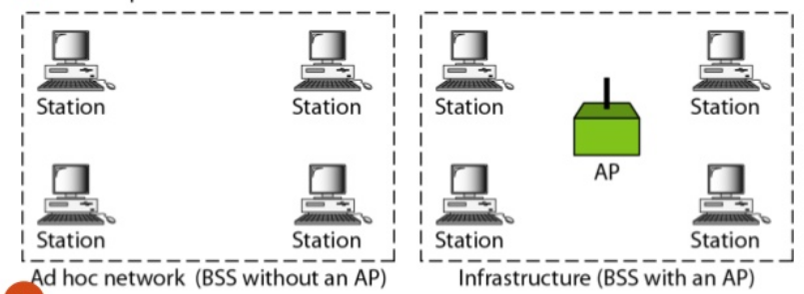
IEEE Standards - Wi-Fi
IEEE 802.11 is a set of MAC and PHY specifications for implementing wireless local area network (WLAN)
IEEE 802.11 standard defines two operation modes: ad hoc mode and infrastructure mode
In ad hoc mode, users communicate directly with each other without the use of a wireless access point (AP) Independent Basic Service Set (IBSS)
In infrastructure mode, users communicate with each other through a wireless AP Basic Service Set (BSS)

Slide 29
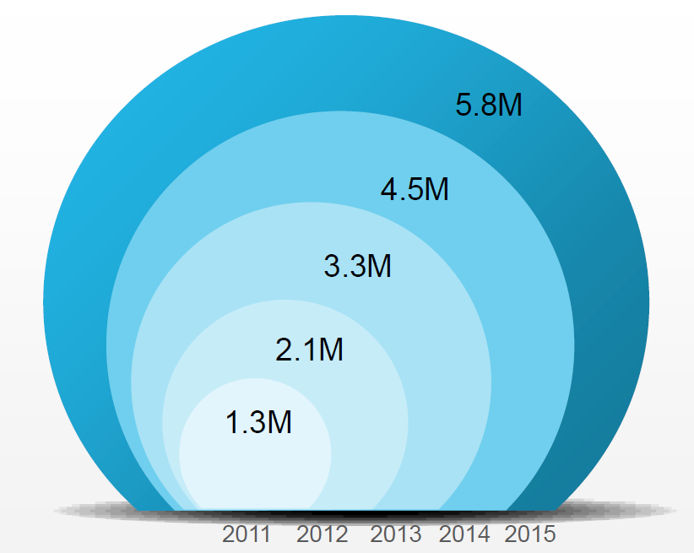
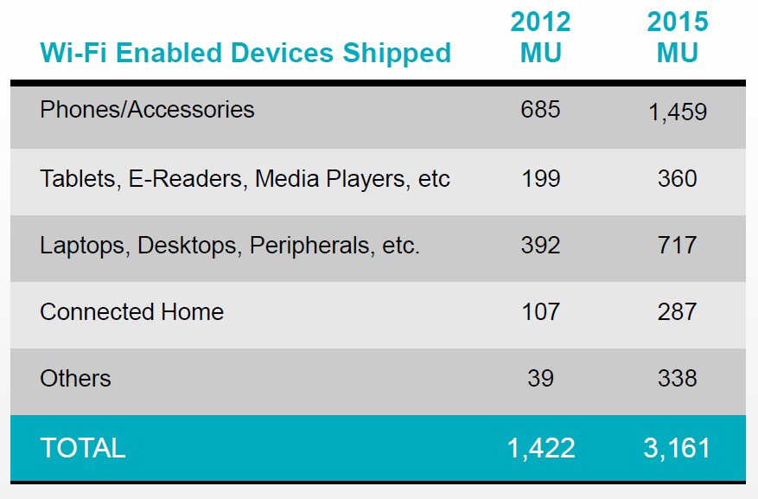
IEEE Standards - Wi-Fi
Wi-Fi is becoming ubiquitous
Number of public hotspots worldwide

Slide 30
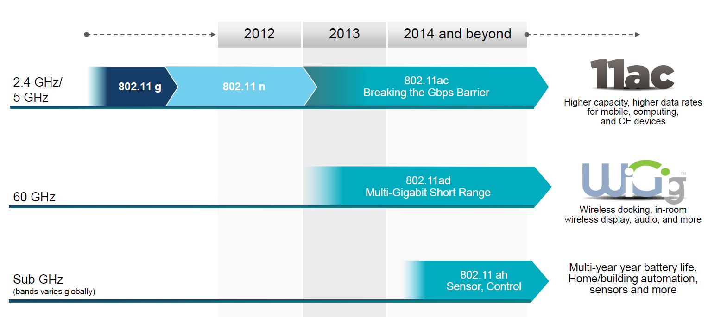
Evolution of Wi-Fi

Slide 31
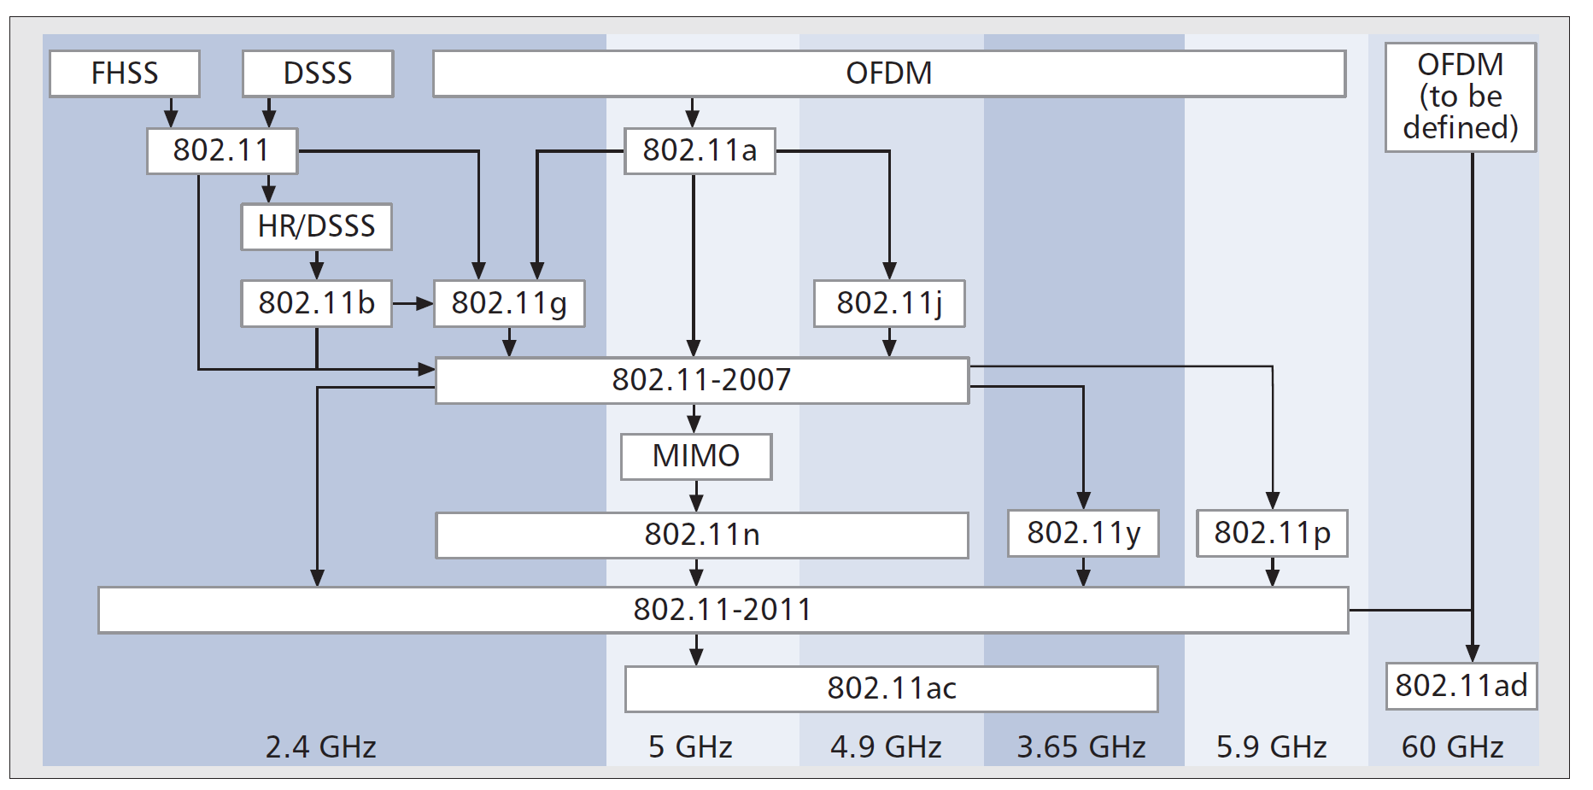
802.11 Standards: PHY Evolution

Slide 32
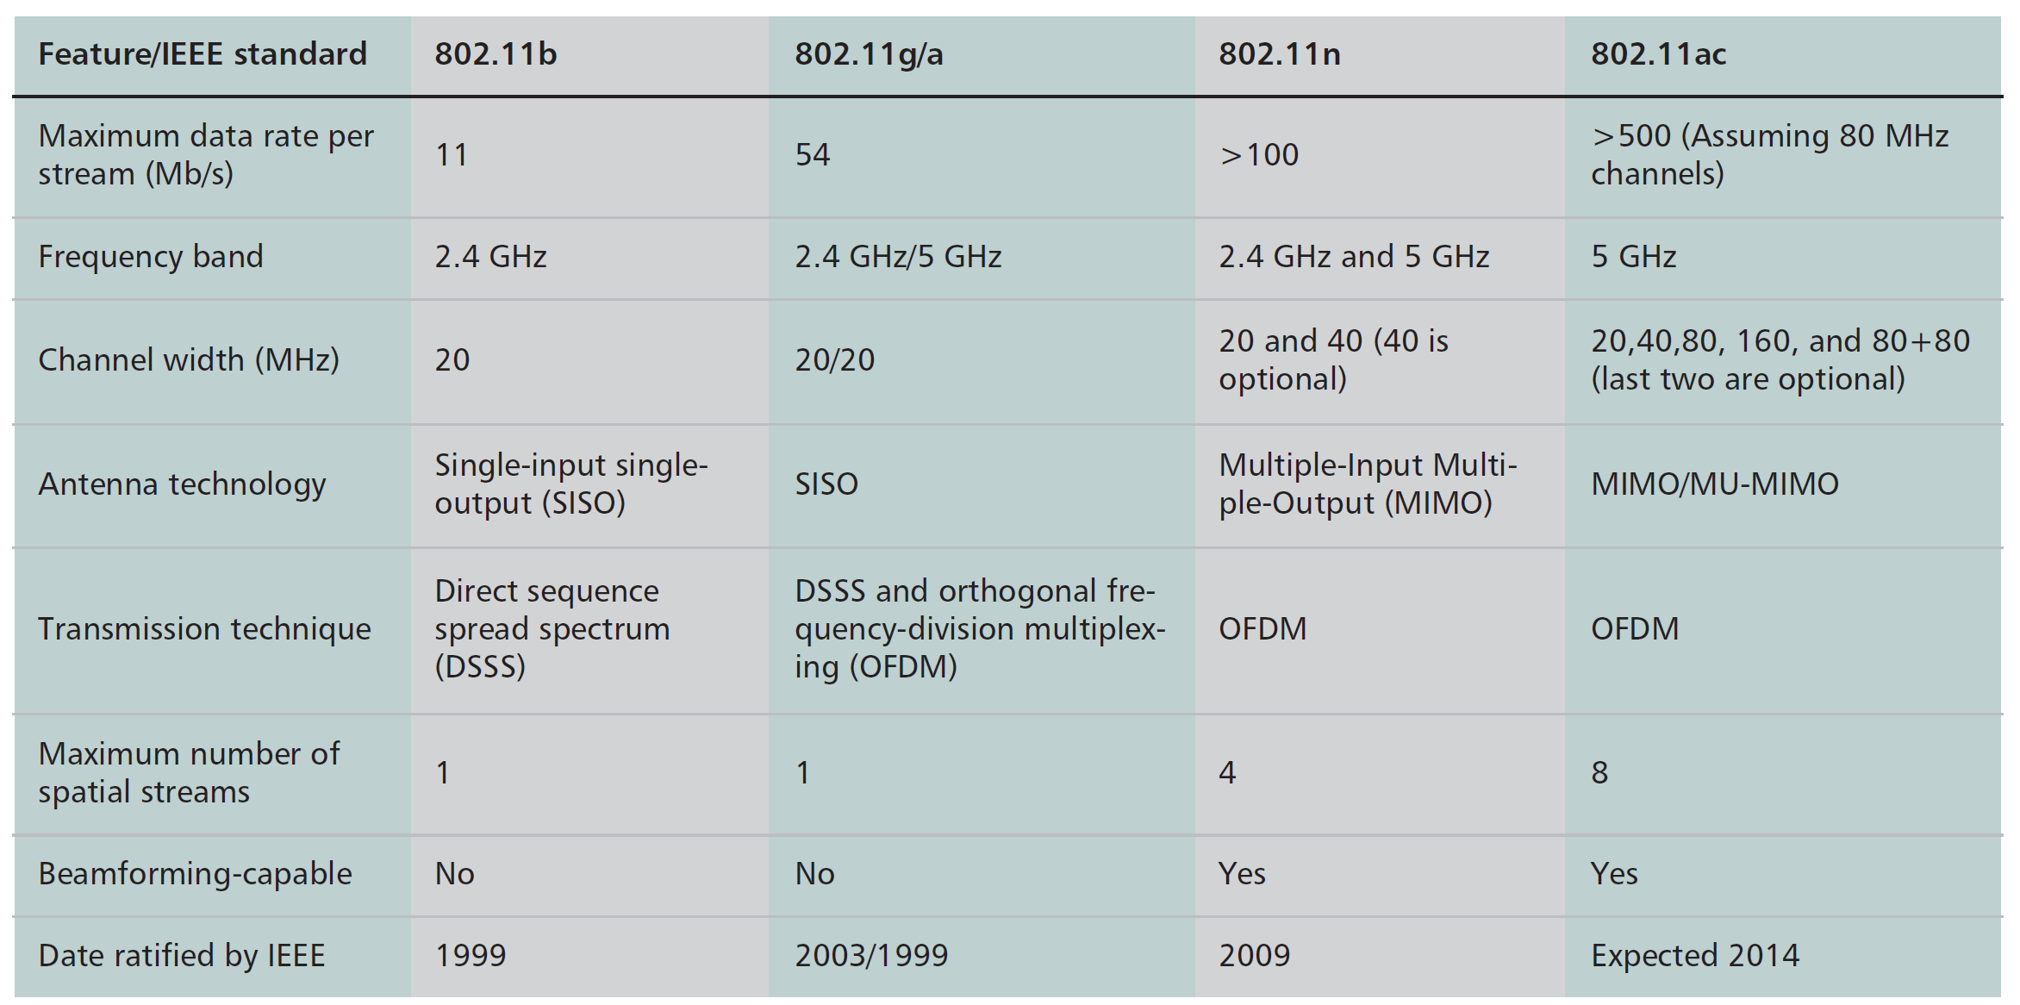
802.11 Standards: PHY Evolution

Slide 33
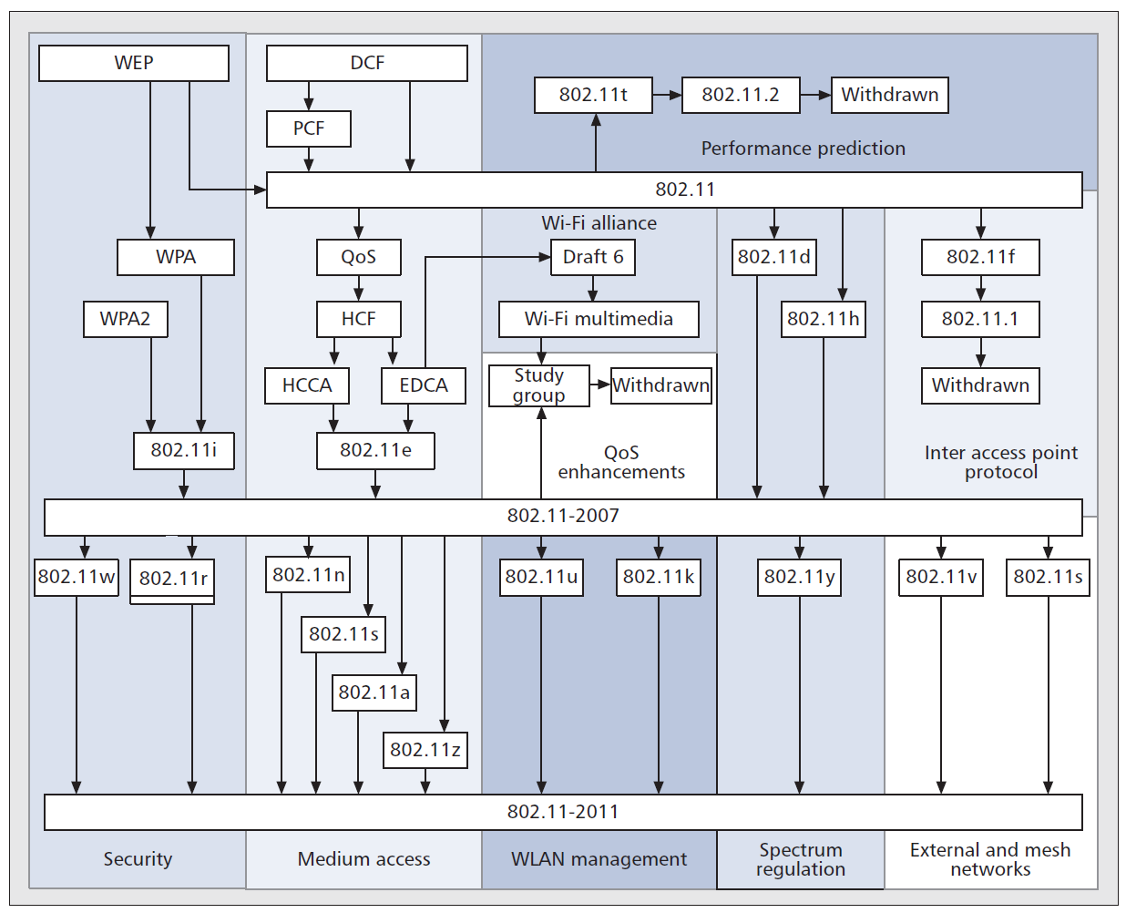
802.11 Standards: MAC Evolution

Slide 34
Original 802.11 MAC
Point Coordination Function (PCF)
Polled access through AP and distributed access
Contention-free period (CFP) and contention period (CP)
Seldom implemented in practice
Distributed Coordination Function (DCF)
Two-way handshaking: Carrier sense multiple access (CSMA) with immediate ACK
Four-way handshaking : RTS/CTS exchange (optional)

Slide 35

Original 802.11 MAC
Two-way handshaking CSMA-based MAC mechanism
Distributed inter-frame space (DIFS)
Each user has to sense the channel idle for a DIFS prior to transmission
The discrete-time binary exponential backoff mechanism
The backoff time is selected according to a uniform distribution in the interval (0,CW)
Once the data packet is received successfully
The receiver waits for a period of time called short inter-frame space (SIFS)
Then , it sends an acknowledgement (ACK)

Slide 36
Original 802.11 MAC
Four-way handshaking RTS/CTS access mechanism
Improves throughput performance
Resolves hidden terminal problem
SIFS
DIFS
DIFS
USER1
DATA
5 4
RTS
3 2 1
ACK
2 1
RTS
DATA
6 5 4
USER2
CTS
ACK
Contention
Contention

Slide 37
802.11 MAC Enhancements
802.11e enhances DCF and PCF through Hybrid Coordination Function (HCF), to support multimedia applications with QoS
HCF controlled channel access (HCCA)
Improved variant of PCF requiring a central coordinator that schedules medium access.
No device implementing HCCA is known to exist in the market.
Enhanced Distributed Channel Access (EDCA)
An extension to the legacy CSMA-based DCF mechanism
Supports four traffic categories: video, voice, best effort, background
Enables service differentiation
EDCA variant called Wi-Fi multimedia (WMM)

Slide 38
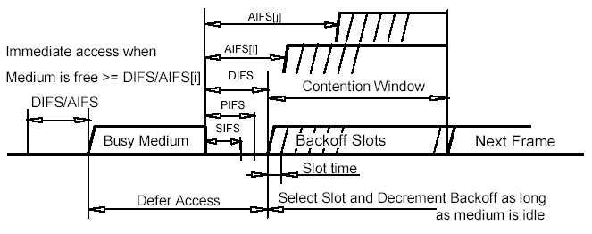
Enhanced Distributed Channel Access (EDCA)
Applications assign each data packet to an AC
Packets are added to one of four independent transmit queues
Different inter frame spaces and contention windows for ACs
Data packets with higher priorities get higher chance of access

Slide 39
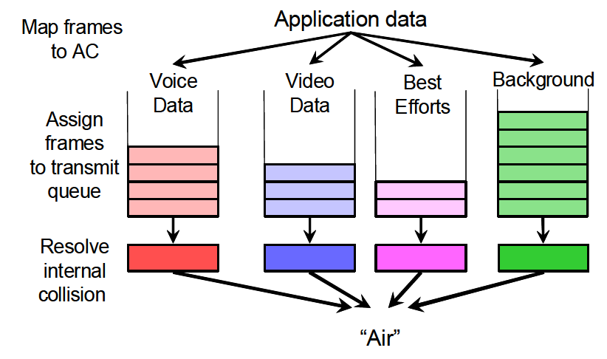
Enhanced Distributed Channel Access (EDCA)
Internal contention

Slide 40
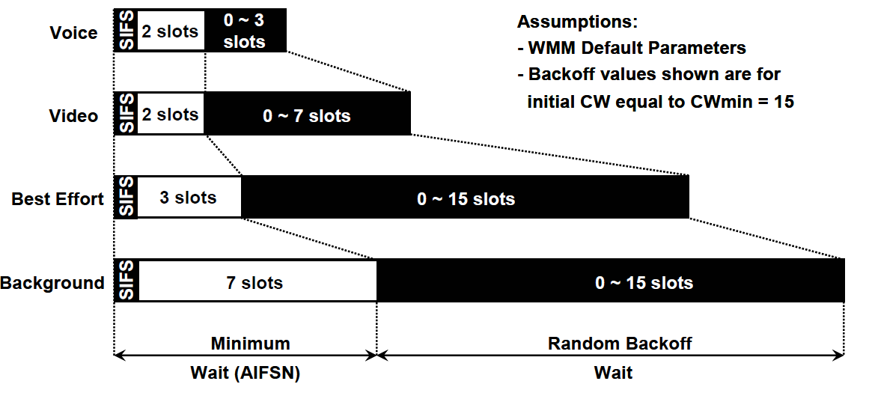
Enhanced Distributed Channel Access (EDCA)
Backoff mechanism

Slide 41
EDCA – Transmission Opportunity (TXOP)
In addition to the differentiation & prioritization, 802.11e introduces TXOP.
A TXOP is a bounded time interval during which a station can send as many frames as possible (as long as the duration of the transmissions does not extend beyond the maximum duration of the TXOP).
A station cannot transmit a frame that extents beyond a TXOP. If a frame is too large, it should be fragmented to smaller ones
Advantages
Reduces the problem of low rate stations gaining an inordinate amount of channel time
Reduces network overhead (due to backoff for each single frame transmission)

Slide 42
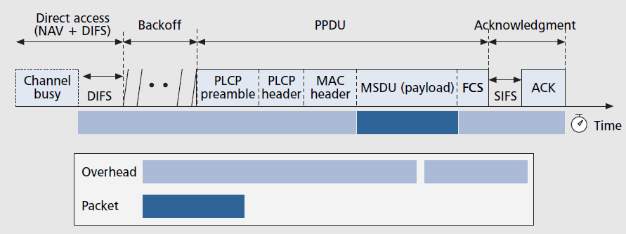
802.11 MAC Enhancements
Frame Aggregation
Required procedure that each single packet traverses from the time it arrives at the MAC until it is successfully received by the receiver
To improve throughput reduce frequency of PHY and MAC headers

Slide 43
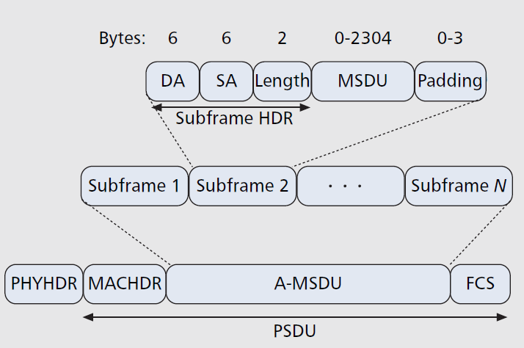
802.11 MAC Enhancements
Frame Aggregation
To reduce overhead and waiting time, one solution is concatenating or packing multiple packets together and adding the overheads over the group rather separate ones

Slide 44
802.11 MAC Enhancements
Block Acknowledgment
All the frames sent (during a TXOP period) are acknowledged by a unique Block Acknowledgement (BA) instead of an ACK frame for each frame transmitted
The station transmits a request for BA (BAR), and the receiver respond with BA after a SIFS period
Missing frames are retransmitted
Can significantly reduce management overhead

Slide 45
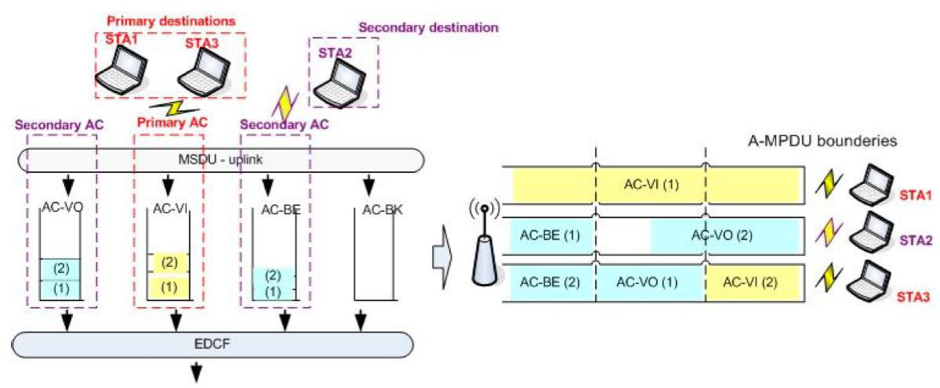
802.11 MAC Enhancements
TXOP Sharing or MU-TXOP
Enables multiple downlink traffic streams to multiple receiver stations simultaneously

Slide 46
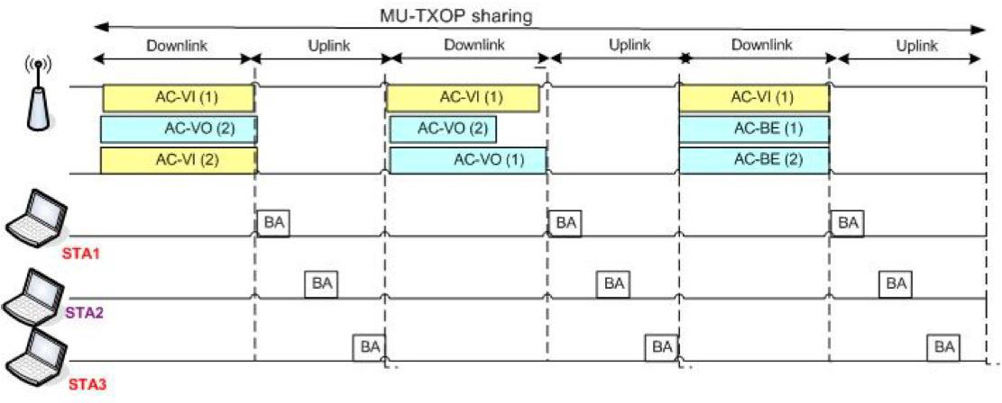
802.11 MAC Enhancements
TXOP Sharing or MU-TXOP

Slide 47
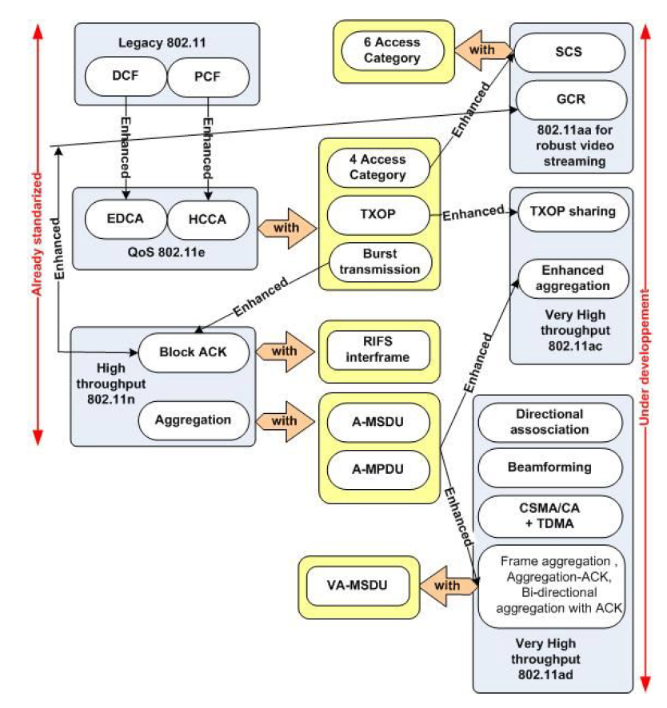
802.11 MAC Enhancements
All expected MAC enhancement

Slide 48
State of the Art: IEEE 802.11ac
Operates in the 5GHz band
Key features that enable data rates up to 6.9Gbps
Up to 8 antennas and spatial streams
Wider channel BW (20/40/80/160MHz)
Downlink multi-user MIMO
256 QAM
First generation ac chips are already available in the market
Usage cases cover both enterprise and home
Focus is on link throughput, rather than efficient use of spectrum resources
11ac is backward compatible with 11a and 11n

Slide 49
IEEE 802.11ac Usage Models
Wireless Display | Desktop Storage & Display
 | Projection to TV or projector in conf room (lightly compressed video)
 | In room gaming (lightly compressed video)
 | Streaming from camcorder to display (lightly compressed video)
 | Broadcast TV field pick up
Distribution of HDTV | Lightly compressed video streaming around the home
 | Compressed video streaming around home
 | Intra large vehicle (e.g. airplane) applications
 | Wireless networking for office
 | Remote medical assistance
Rapid upload/download | Rapid sync-n-go file transfer
 | Picture by picture viewing
 | Airplane docking
 | Movie content download to car
 | Police / surveillance car upload
Backhaul | Multi-media mesh backhaul
 | Point-to-point backhaul
Outdoor campus / auditorium | Video demos / tele-presence in auditorium
 | Public safety mesh
Manufacturing floor | Manufacturing floor automation

Slide 50
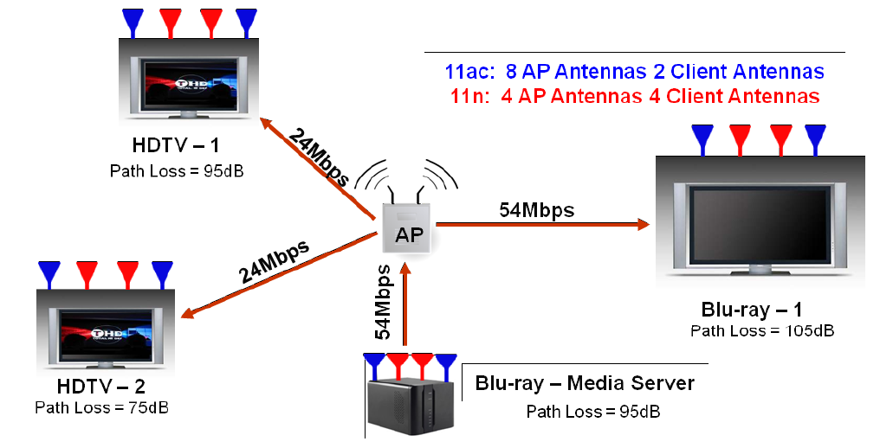
IEEE 802.11ac Usage Model Example
Delivering multiple HD video streams simultaneously
802.11ac usage model example: In-home HD content distribution

Slide 51
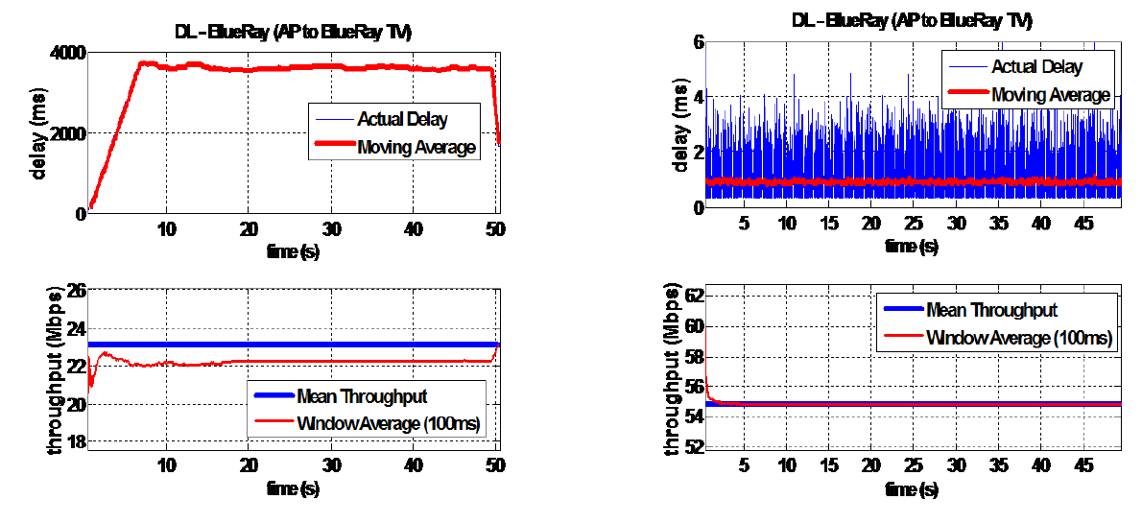
802.11ac Usage Model Example
802.11ac in 40 MHz with eight antenna AP can supports two HD video streams at 24 Mbps each and two Blu-Ray video streams at 54 Mbps each

Slide 52
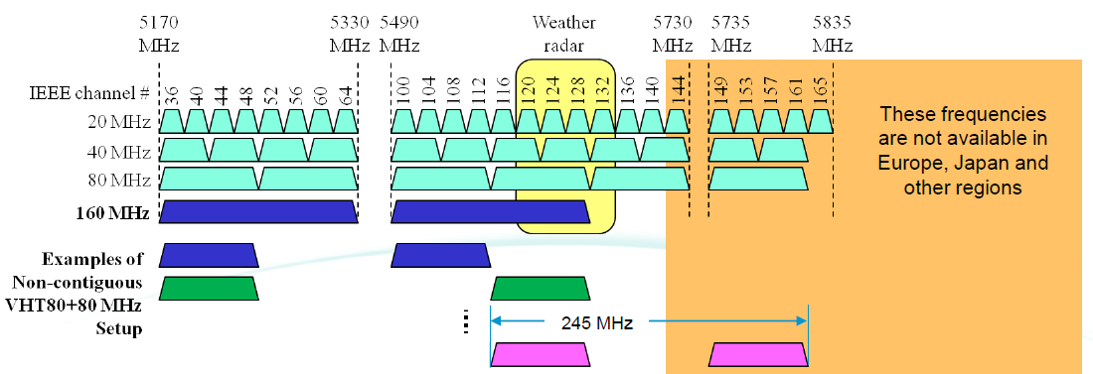
IEEE 802.11ac Features
Mandatory 5 GHz operation
Less interference and more non-overlapping channels
Wider bandwidth
It introduces 80MHz and 160MHz in addition to 20MHz and 40MHz.

Slide 53
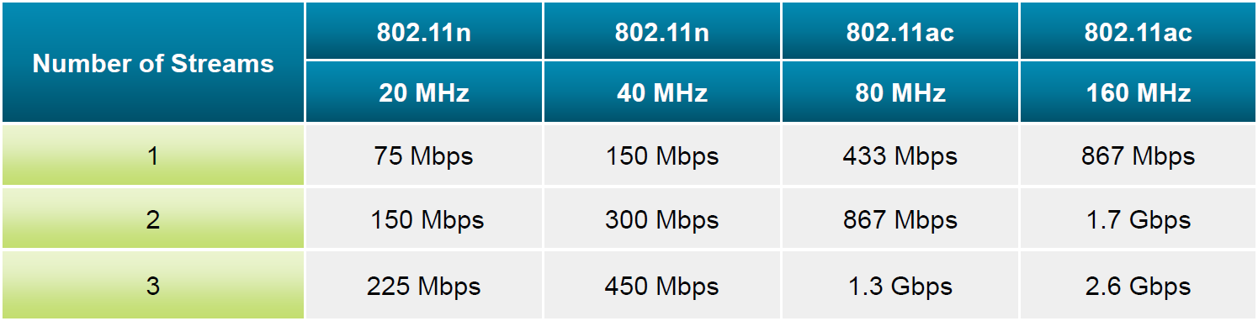
IEEE 802.11ac Features
Higher order modulation
256 QAM instead of 64 QAM in 802.11n
Higher order MIMO
Maximum number of spatial streams is increased to eight

Slide 54
IEEE 802.11ac Features
Multi-user MIMO
First Wi-Fi standard introduces MIMO, to serve up to four clients simultaneously.
Standard-based beamforming
802.11ac defines a single explicit compressed feedback for beamforming
Backwards compatibility to 802.11a/n
802.11ac enables coexistence by a backwards compatible preamble which understandable by 802.11 a/n

Slide 55
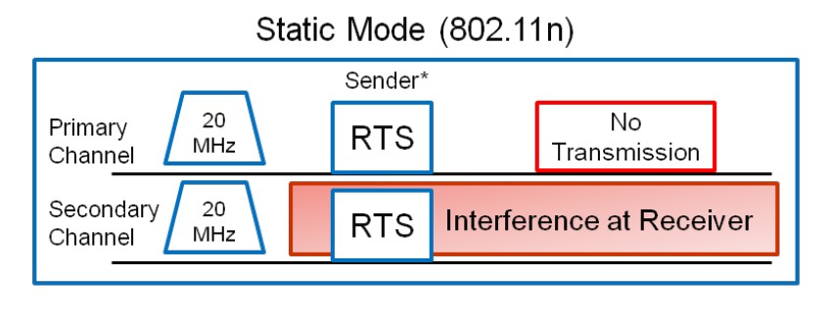
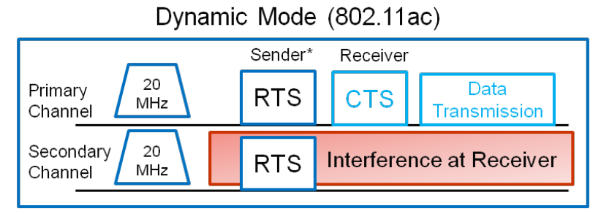
IEEE 802.11ac Features
Improved interference detection threshold
Enhanced RTS/CTS with bandwidth indication
Enables dynamic bandwidth management and optimizing the use of wider bandwidth in an efficient manner
Each Network has a 20 MHz primary channel for carrier sensing
Once the access to the primary channel is obtained, additional secondary channels for wider bandwidth may be added.

Slide 56

Coverage

Slide 57

Coverage
Single Family Units =>Range is short enough
Possible solutions for Multi Dwelling Units
1- Radio resource management
2- Primary channel assignment
3- Beamforming

Slide 58

State of the Art: IEEE 802.11ad
60 GHz operation Throughput intensive applications
2.16GHz channel bandwidth
Short range Personal Area Network (PAN)
Personal Basic Service Set (PBSS)

Slide 59

State of the Art: IEEE 802.11ad
Beamforming would be the key technology to enhance 60GHz range.
Beamforming utilizes multiple antenna elements to form a beam toward a certain direction with increased signal strength
However, beamforming could only be functional after discovery and training of the target device.

Slide 60

State of the Art: IEEE 802.11ad
60GHz Training Frame could be configured in a way that it contains multiple beam patterns
60GHz Training Frame could be signalled with 2.4/5GHz frame
The beamformee could report back the strongest beam pattern it receives
Feedback can be sent using 2.4/5GHz training frames

Slide 61
State of the Art: IEEE 802.11ad
MAC Design
Needs to support high throughput, directional communications and QoS improvement
Scheduling scheme, wherein a station is allowed to access the channel without a central controller involvement is preferable; this is facilitated by having the central controller distribute the channel time schedule
Good framework for QoS, power management
Spatial reuse
Good for BSS as physically distributed stations can be scheduled simultaneously
Lends itself well to directional communication since stations know who they will talk to and hence can steer their antenna to the right direction,

Slide 62

State of the Art: IEEE 802.11ad
Beacon frame format:
BT/Directional Association: AP broadcasts beacons in different direction
A-BFT/Beamforming: Beamforming processing
AT: Announcement Time: Management request-response frame ex-changes between AP and station
CBP: Access during CBP is based on a modified 802.11e EDCA access mechanism that is fine tuned or directional communication
SP: TDMA access mechanism Access: during

